Slide 1
Addressing Animal Cruelty
gia

Slide 2
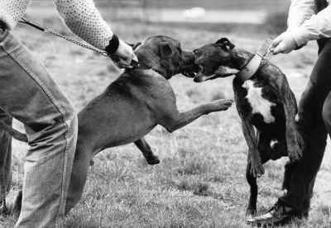
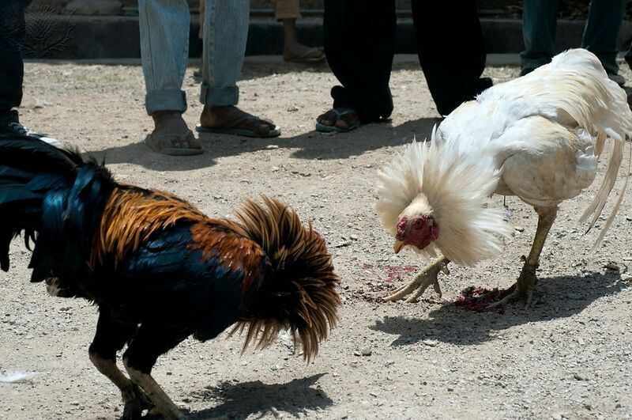
What is the issue?
All around the world different animals, domesticated and wild, experience abuse and neglect. Animal cruelty takes on many different forms such as: industrial animal agriculture farms, animal fighting, puppy mills, and pet neglect. In every part of the world there are 180 million animals who are being neglected, starved, beaten, and not well taken care of.

Slide 3
Call to action
I encourage you to report any signs of animal abuse and/or neglect. Whether it be someone you know or a complete strangers. Report to the authorities or a local animal humane organization shelter, Intervene if you ever witness animal abuse and/or neglect. Potentially decrease your intake on meat and dairy products, as doing so could potentially decrease the amount of animals that are slaughtered per year by 23%.
You could help these helpless and voiceless animals by being their voice.
DO NOT HESITATE TO HELP ANY ANIMAL YOU SEE SUFFERING.

Slide 4
